Slide 1


FORGOTTEN 21?
A Case Study by Team Meraki
UTSAV | AASHRITH | AARYA

Slide 2
“Forever 21 forgot to remain relentless and now may become Forgotten 21 if they don’t shift their relevance and brand strategy quickly”.
Let’s dive deeper into this and see where they went wrong

Slide 3


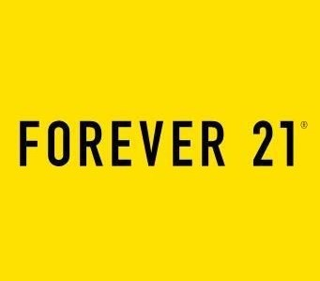

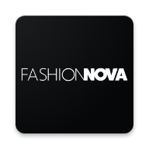


Lagging behind compeers
Customer experience, Website Visits
Customer experience, Website Visits
Operational Strategy
Online marketing and design frequency
Customer experience, Website Visits
Brand Value, Website Visits
Team Meraki
Team Meraki
*Appendix 1

Slide 4
Once a market leader, now filled for bankruptcy, what went wrong?
Digital Branding
Private Authority
Supply Chain
Sustainability
In-store Experience
Online Platform is not competitive enough with rival brands
99% of the company is privately-owned by promoters , with obsolete leadership group
Geographical tastes not considered in production line
No chief value drivers for reducing carbon footprint being a fast fashion brand.
Understaffed and
Outdated layouts with negligible technology utilization
Team Meraki
*Appendix 2

Slide 5
“Value Migration is inevitable,necessary and highly desirable”
Fast Fashion is not dead(yet)

Slide 6
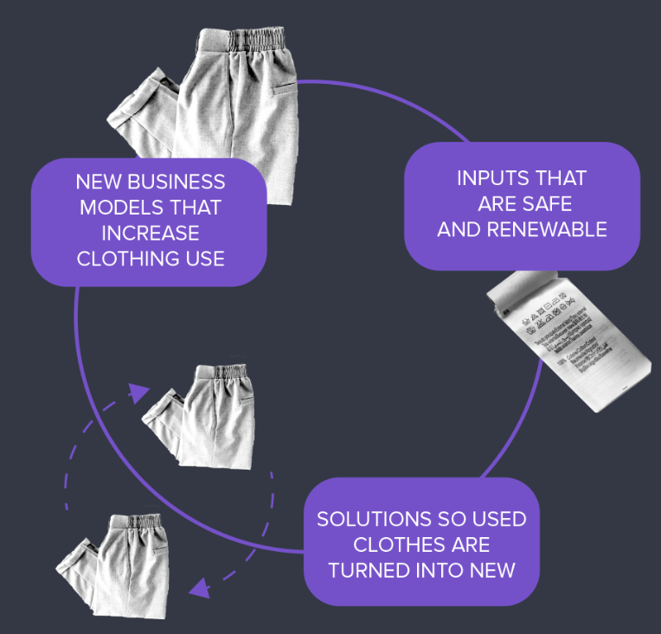
CIRCULAR FASHION
A Renewable Adjunct to a Still Breathing Segment
Moving to a circular system in fashion,$565 billion dollar economic opportunity can be unlocked.
Easily implementable by extending the current supply chain.
Solution to sustainability issues.
Team Meraki
Team Meraki
*Appendix 3

Slide 7

6
4
Promotions
And
Branding
Franchise Model
Improving
User Experience
Launch of Green 21
2
Better Corporate Governance Structure
Revamping
Brick-And-Mortar
Stores
Focus on Sustainability plans
7
5
3
1
Three Year Strategic Plan
Team Meraki
Team Meraki

Slide 8
1
Better Corporate Governance Structure: Need more experienced, independent and diverse board of directors.
2
Revamping stores: To improve in-store experience. Conversion to experience stores.
3
Focus on Sustainability: Important aspect due to growing Environmental concerns. Shift to Circular Model. Used clothes drop box, Fashion Bins.
4
Improving User Experience: Current website not up to industry standard. Implement in store pickup or return/exchange, same day delivery, Perfect Size Feature.
Team Meraki
Team Meraki

Slide 9
5
Launch Green 21: New wing which would be responsible for articles made from recycled goods like raincoats, earrings, fanny packs, bracelets, etc.
6
Promotions and Branding: Aggressive Social Media and Guerrilla Marketing to promote Green 21. Collaborations with sustainability ambassadors.
7
Franchise Model: Stores are very spacious and furnished. Franchisee would pay to get license and pre-existing store. They would have a better idea about the region.
Team Meraki
*Appendix 5

Slide 10
“The Future of Retail is Blended”

Slide 11
Omnichannel Retail - The top priority
RETAIL STORE
ONLINE
Better pricing and convenience of cash-free home-delivered shopping.
Incentive of trying before buying and verified fittings.
Increased retail sales
Better logistics framework
Effective Marketing
Customer Convenience
By showcasing the catalogue online and offering an offline pick-up option for online stores, more customers are likely to be drawn to the retail stores
An ecosystem built by network of retail stores and online systems helps manage the stock requirements.
An online ecosystem facilitates an economical approach to effective markets.
A seamless integration of online network in retail stores, organizes the product ranges, makes information accessible.
Fun store experience backed by digital capabilities
Team Meraki
Team Meraki
*Appendix 3

Slide 12
“The number of website visits for H&M was 5 times more than that of Forever 21 in the month of December 2019 ”
This shows serious E-commerce Negligence

Slide 13
E-commerce Negligence
Inventory mismanagement
Lack of diverse sizing and Body shape diversity, which is at the core of the business. Competitors like Fashion Nova have managed to attract women with body measurements that generally don’t fit within standard sizing.
Digital marketing and branding
Only 16% of the company’s sales come through online channels. This is due to lack of attention and activities on their platforms
Customer Engagement
Lack of personalized recommendations and use of collected data
Non-existing linkage between online network and physical stores.
Team Meraki
Team Meraki

Slide 14
Convenient purchase to delivery recommendations
With an omnichannel ecosystem built, online-to-offline and offline-to-online strategies must be used.
Data Collection
Product purchased
Utility of products
Frequency of purchase
Location of order and delivery
Necessary Changes
Refreshed categorizing strategy
For indelible shopping experience, price-customized approach, nudge for more relevant products based on personal utility than mass trend
Personal Profiling
Building individual profiles based on customer’s online and offline purchasing habits.
Team Meraki
Team Meraki
Team Meraki

Slide 15
update
Profile recognised
based on current market demand and trend
Backend system
Personalised recommendations
for stock management
A Symbiotic Ecosystem
Product identified in a distribution channel
Online convenience
Offline/Immediate requirement
update
Home delivery
Product searched in nearby stores
Product Purchased
Instock
Product purchased
Out of stock
Team Meraki
Team Meraki

Slide 16
Reinvented 21
01
Understanding customer habits
Attract customers with wider product portfolio catering to broader customer demographics.
BOPIS, O2O models
Convenient and easy shopping
02
Singular view of the customer
Optimal shopping experience across all channels
Anticipate and prepare future needs
Improved technology and systems
03
Spread of information across all channels consistently and timely manner
Better customer loyalty
Better brand visibility
Team Meraki
Team Meraki

Slide 17
IS FOREVER 21 DEAD?
CAN FOREVER 21 MAKE A COMEBACK?
WILL FOREVER 21 EVER BE BACK AT THE TOP AGAIN?
Team Meraki

Slide 18
Cost Reduction
Zonal Economies of Scale:
where and when to concentrate on a particular channel more than the others for a far more profitable return.
1
2
Franchise Model:
Franchise out the license as well as the store to the regional players.
.
Smaller Stores:
Runner smaller stores reduces operational costs.
3
4
Wider/ Distributed Supply Chain:
Better Networking can place order quickly, provides competitive advantage over others without lowering prices
Team Meraki

Slide 19
“THANK YOU!”

Slide 20
Appendix 1
Company | Frequency of Fast Fashion | Revenue( in million $) | Website visits in December 2019 | Customer Satisfaction and Retention | Sustainability | Competitions with F21
Zara | Twice a week | 18900 | 78.57 M | 4 | 3 | net sales and customer experience
H&M | Once in 2 weeks | 23232 | 103.51 | 1 | 3 | customer experience
Uniqlo | Once in 2 weeks | 8066 | 68.13 M | 7 | 3 | customer experience
Gap | Once in 8 weeks | 1600 | 68.34 M | 8 | 3 | brand value
Urban Outfitters |  | 3950 | 21.18 M | 3 | 2
Fashion Nova | 600 per week | 1200 | 25.15 M | 5 | 1 | online presence
ASOS | twice a day | 2400 | 76.29 M | 6 | 3 | customer experience
F21 | 400 per week at its peak | 3400 | 21.50 M | 2 | 2
Team Meraki
Team Meraki

Slide 21
Appendix 2
“The Forever 21 website really was the poor relation to their store experience having had little attention spent on developing the site until very recently. Thus the design is dated when compared to competitors like H&M and Zara—something that modern-day consumers are no longer willing to countenance.” - Forbes
https://www.forbes.com/sites/callyrussell/2019/08/30/what-went-wrong-with-forever-21/#5033bcb53e59
“It has been reported that the desire for the founders to retain overall control of the business in any restructuring process is a blocker in some of the restructuring talks the business has been holding. It was also reported by Bloomberg in June that the company had asked some landlords to take a stake in the business as a way of raising the funds the business needs to continue to trade.” - Forbes
https://www.forbes.com/sites/callyrussell/2019/08/30/what-went-wrong-with-forever-21/#5033bcb53e59
Analysts also say Forever 21 failed to understand some of the markets outside of America as it opened more shops in places such as China and London.
https://www.cnbc.com/2019/12/11/heres-why-forever-21-went-bankrupt.html
https://goodonyou.eco/how-ethical-is-forever-21/
https://articles.bplans.com/key-business-plan-components-that-forever-21-fatally-missed/
Team Meraki
Team Meraki

Slide 22
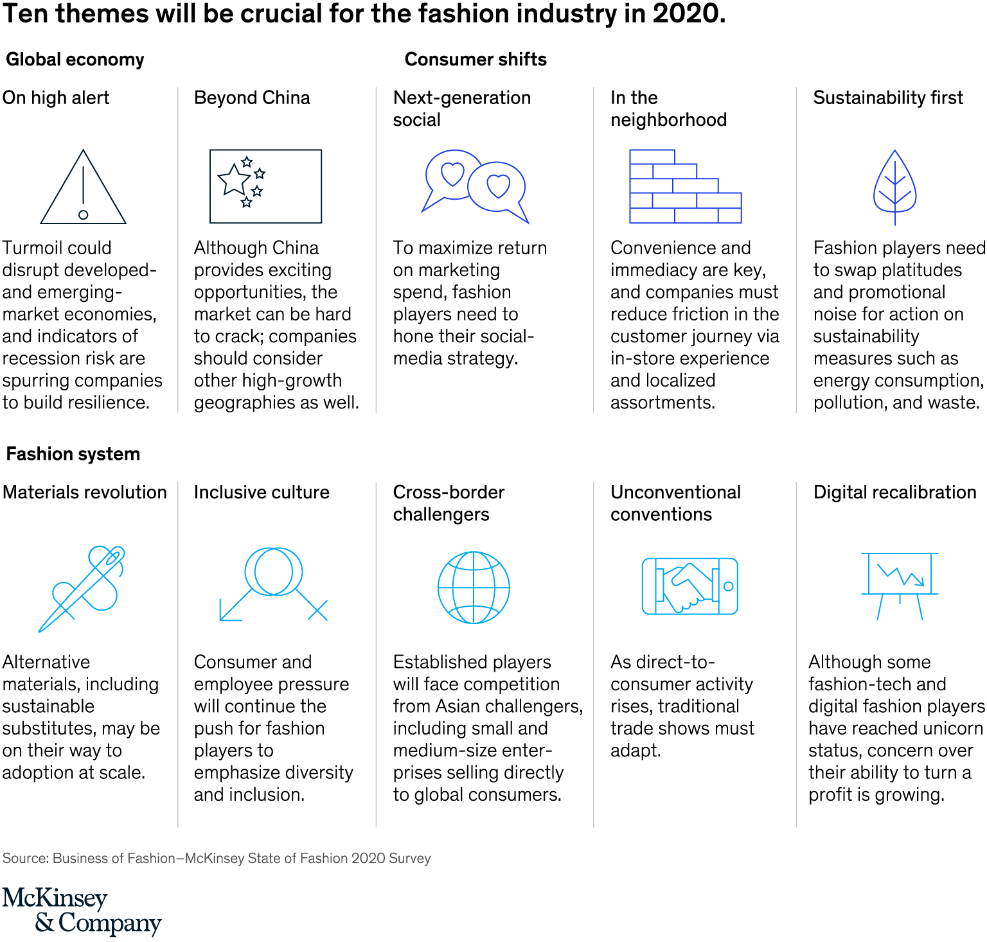
Appendix 3
https://www.ellenmacarthurfoundation.org/explore/fashion-and-the-circular-economy
Why Omnichannel is Important in the Retail world? [2018 Insights]
https://imanila.ph/2019/10/16/how-forever-21-was-crushed-by-ecommerce/
Team Meraki
Team Meraki

Slide 23
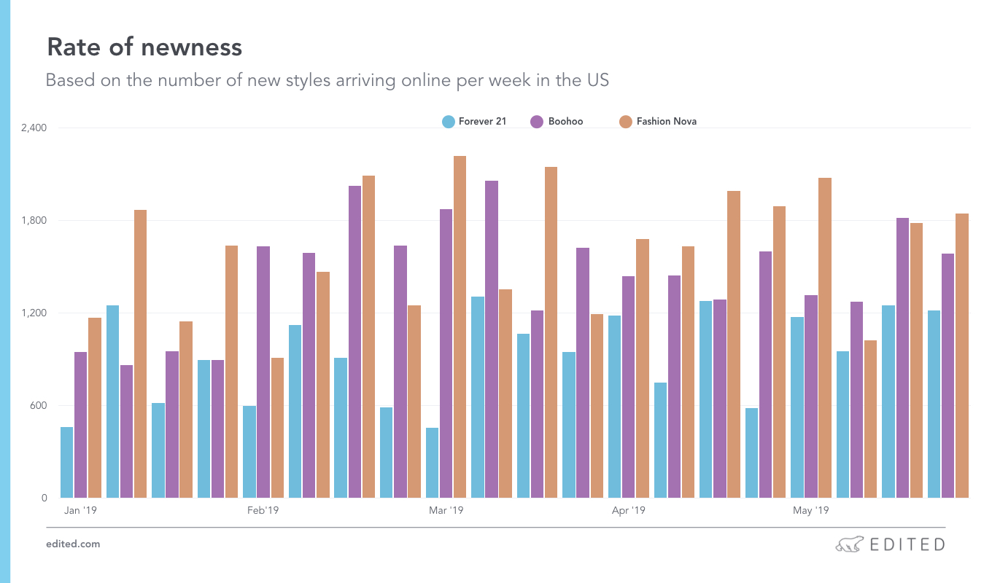
Appendix 4
Franchisee Model:https://www.entrepreneur.com/article/252591
https://qz.com/quartzy/1719044/forever-21s-bankruptcy-doesnt-mean-fast-fashion-is-dead/
Team Meraki
Team Meraki

Slide 24
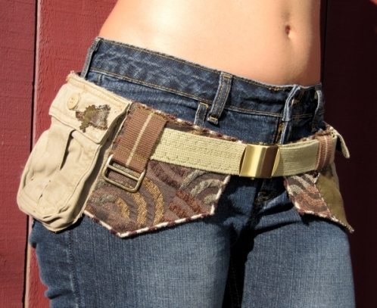
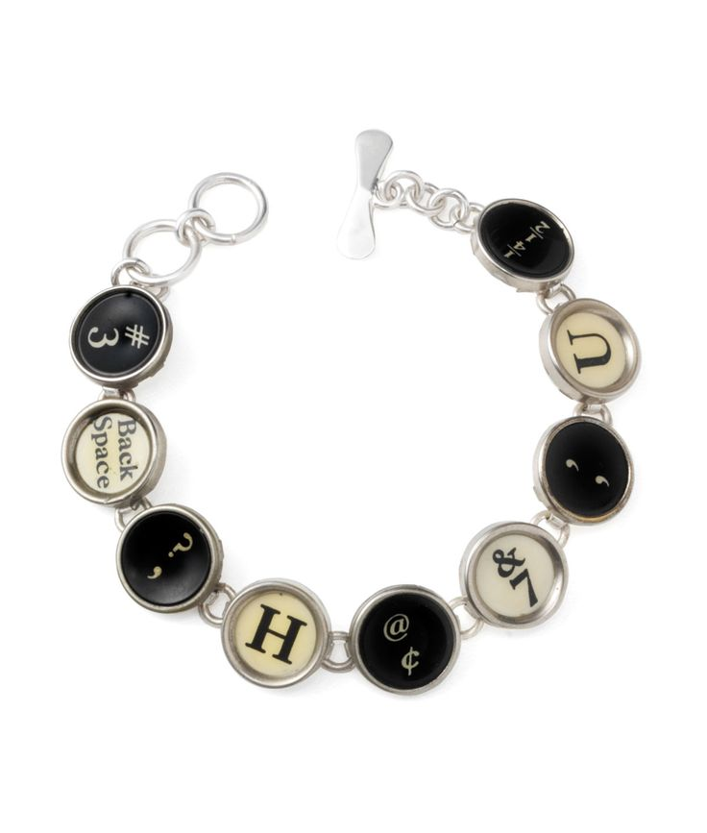
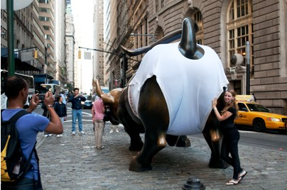
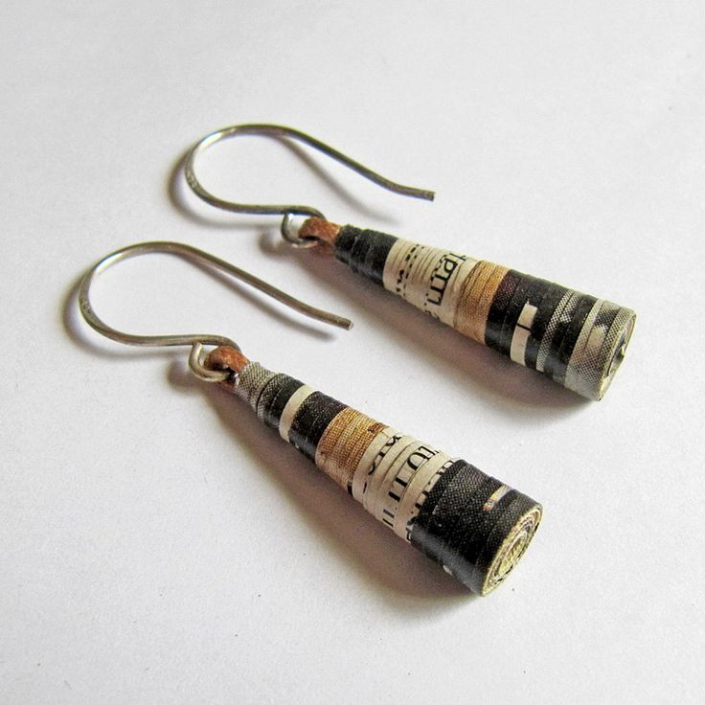
Appendix 5
Pocket Fanny Pack
Typewriter Bracelet
GoldToe’s Unique Marketing
Paper Earrings
Team Meraki
Team Meraki

